Slide 1
A Study on Benchmark Datasets for Human Disease Genes
-The more we Learn, The more we Serve

Slide 2
Group Members :
Supervised By:
Dr. S.M.A. Al-Mamun
Mahin Hossain ID: 190204061
MD Shihabul Islam Shovo ID: 190204075
MD Fardin Jaman Aranyak ID: 190204093
Md. Symum Hossain ID: 190204105

Slide 3
Objective & Goal
Continuous Research and Collaboration
Personalized Medicine
Clinical Applications
Limitations of Models
Enrich the Benchmarking Datasets.
Risk Assessment
Early Diagnosis

Slide 4
Human Gene-Disease datasets
Availability: Scattered over literature as free-text data, Unorganized, Not recorded properly
Usefulness: Not compatible for computational analysis
Work compatible: Not suitable and slow process
Availability: OMIM, DisGeNet, GAD, GWAS
Usefulness: Cytoscape plugin and Computational analysis
Work compatible: Representable as GDAs graph
Raw Datasets
Benchmark Datasets

Slide 5
State of art Genomics Datasets
OMIM
DisGeNET
CTD
UniPort
GAD
GWAS
Catalog
Orphanet
ClinVer
dbGaP
GeneCards
GWAS Central

Slide 6
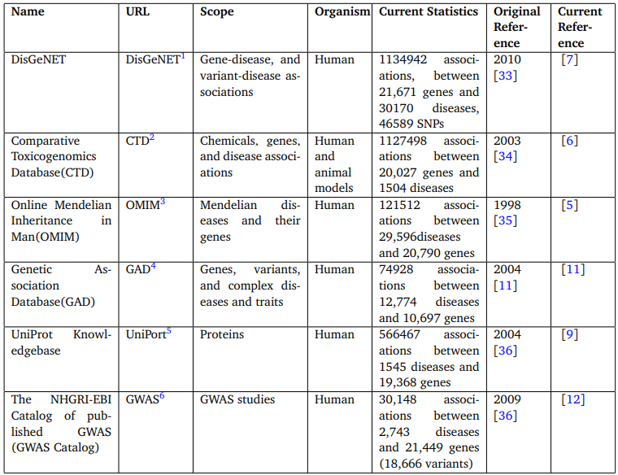
Resources On Genotype and Phenotype

Slide 7
Tools for Genomic Data Extraction
BeFree
BioBERT
PubTator
MetaMap

Slide 8
DisGeNet- A Dataset of Gene-Disease Associations
Released On
Raw Data Source
Data Extraction
September, 2010
Omim, Unipport, CTD, CURATED
Text mining tools
Repository
Open Access
Curated Data Source
Access DisGeNET
Informations
Mendelian, Curated repositories, GWAS catalogues, Scientific literature
Web Interface, SQLite database, Cytoscape, Semantic web
GDAs & VDAs

Slide 9
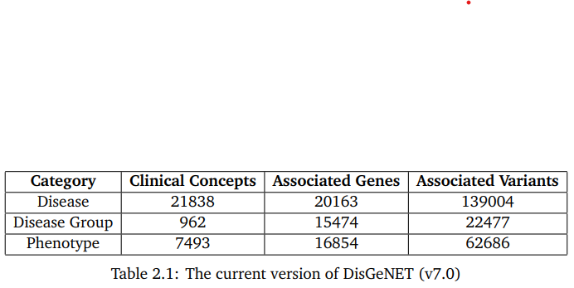
DisGeNet Versions
V4.0 (June,2016)
429, 036 GDAs
17, 381 genes
15, 093 diseases
V6.0 (June, 2019)
628, 625 GDAs
17, 549 genes
24, 166 diseases
V7.0 (June, 2020)
1, 134, 942 GDAs
21, 671 genes
30, 170 diseases
Detailed Statistics of the DisGeNET’s Current Version: v7.0

Slide 10
OMIM(Online Online Mendelian Inheritance in Man)
First Introduced
Text Data
Data Format
In the 60s
Expert Curation
Text but structured
Traditional focus
Recent focus
Access OMIM
Mendelian diseases
Complex diseases
Website, API
Category | GDAs | Genes | Diseases
Total | 121, 512 | 29, 596 | 20, 790
Statistics of the OMIM Current Version

Slide 11
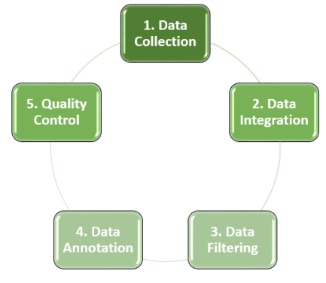
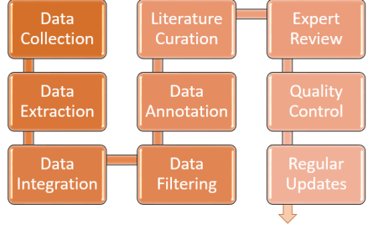
Workflow Diagram
Disgenet
OMIM

Slide 12
Type Of Machine Learning Model
Supervised Learning
Classification
Regression
Unsupervised Learning
Clustering
Dimensionality Reduction
Anomaly detection
Reinforcement learning
Semi-supervised learning

Slide 13
Machine Learning Model for
Gene Disease Association
Decision Tree (DT)
Support Vector Machines (SVMs)
Random Forests (RF)
Neural Networks (NN)

Slide 14
Decision Tree (DT)
Recursively Partitioning
Splitting Until Pure
Root to Leaf
Non- Parametric
Overfitting
HD not
Medical D., Fraud Detection, Customer Segmentation, Risk Assessment.

Slide 15
Support Vector Machines (SVMs)
Optimal Hyperplane
HD yes
Well-suited for Classification
Discrete Category
Image classification, Text classification, Bioinformatics, Anomaly detection

Slide 16
Random Forest (RF)
Combines Multiple Decision Trees
Concept of Bagging
Randomness
Voting
HD yes
Medical D., Fraud Detection, Customer Segmentation, Risk Assessment.

Slide 17

NEURAL NETWORK (NN)
Human Brain
Adaptability
Both (C & R)
Very Effective & Expensive
P, MLP, CNN and RNN
Image Recognition, NLP, Medical D., Speech R., Recommender Systems, Predictive Analytic

Slide 18
Comparative Analysis Between Models
Feature | SVM | Random Forest | Neural Networks | Decision Tree
Classification | Binary and multi-class | Binary and multi-class | Binary and multi-class | Binary and multi-class
Regression | Yes | Yes | Yes | No
Interpretability | High | Low | Low | Medium
Computational complexity | Medium | High | High | Low
Robustness to outliers | High | High | High | Low
Feature scaling | No | No | Yes | No
Table 2.4: Differences Between Models

Slide 19
Summarizing the Analytic Discussion
Model | Description | Advantageous | Disadvantageous
SVM | Supervised | HD data, Robustness, Interpretation | Computational Complexity, tuning
RF | Ensamble | High accuracy, No scaling, Robustness, | Complexity, Hyperparameter
NN | Human Brain | High Accuracy, adaptability | Interoperability, Hyperparameter
DT | Tree Like Structure | Simplicity, Efficiency | Overfitting, Noise S.
Table 2.5: Summary of the Models

Slide 20
Study of Existing Papers

Slide 21
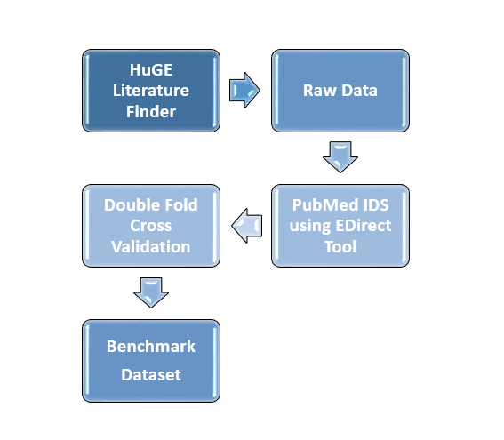
Title: Benchmark data set for breast cancer associated genes._{[1]}
12565 records were processed
Raw data were collected From HuGE Literature Finder
EDirect Tool was used to separate PubMeds
Double Cross Validation were applied
The benchmark Dataset was achieved

Slide 22
Title: Benchmarking network propagation methods for disease gene identification._{[2]}
Identify genes for targeted drug treatment
Data Source is OpenTargets database
12 specialized computer algorithms were used across 22 common diseases
Six different measures used to evaluate algorithm efficacy.
Cross-validation were employed to ensure reliability of results

Slide 23
Title: Genomic variant benchmark: if you cannot measure it, you cannot improve it._{[3]}
Crucial for evaluating variant caller accuracy in genomics research
Dataset Created using diverse sequencing technologies
Establishes pipelines, fosters new sequencing approaches
Short-read technologies widely used but have limitations
Long-read sequencing used for detecting previously undetected SVs

Slide 24
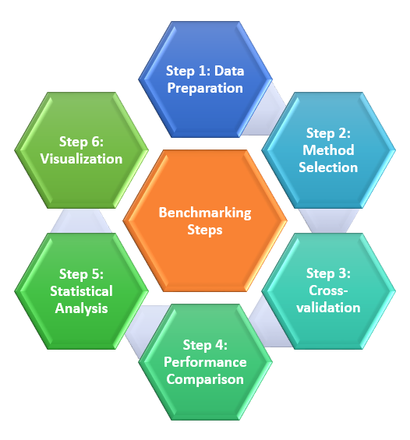
Steps of benchmarking

Slide 25

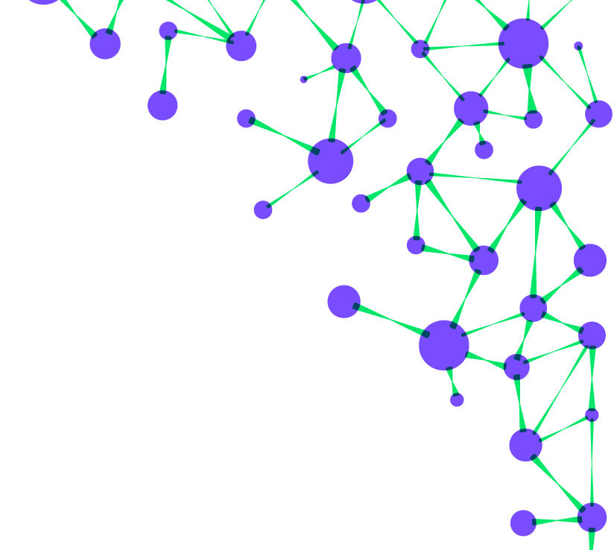

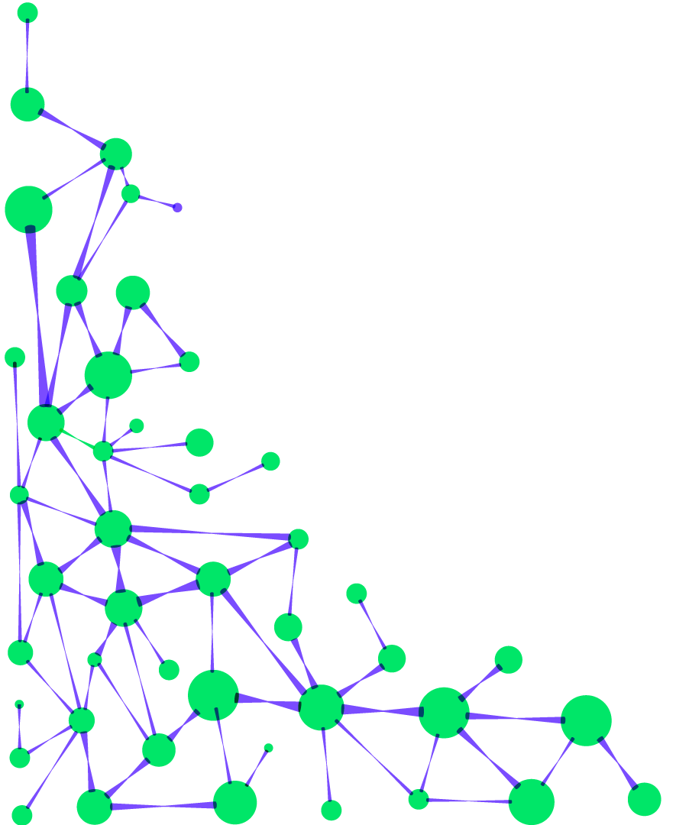
Methodology

Slide 26
S.NO: Serial number
DB_ID: Database identifier
DIS_CLASS: Disease class
GENE: Gene information
PUBMED.ID: PubMed identifier
LACKASSO: Lack of association indicator
TITLE: Title of the publication
YEAR: Year of publication
CONCLUSION: Conclusion of the publication
REF_SENTENCE: Reference sentence
ASSOCIATION_CLASS: Association class
REF_GENE: Reference gene
GENE_NEW: New gene information
WEIGHT: Weight value
Dimension of the dataset: 14
It doesn't directly provide numerical values for the Interpretability, Robustness to noise, Handling of missing data, and Computational complexity for any ML model

Slide 27
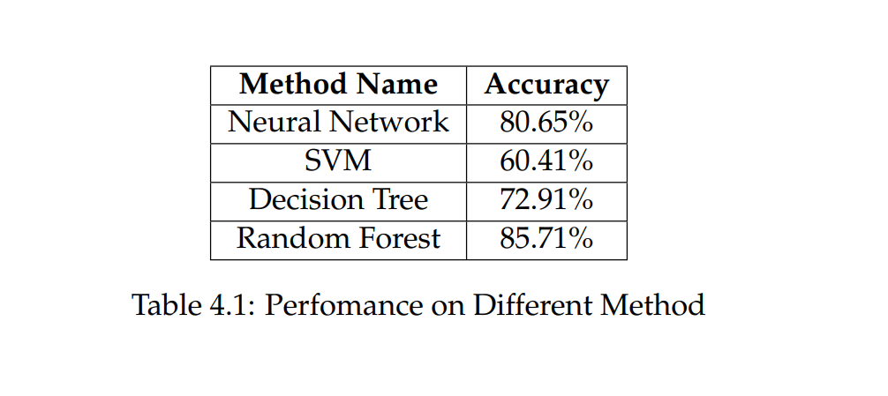
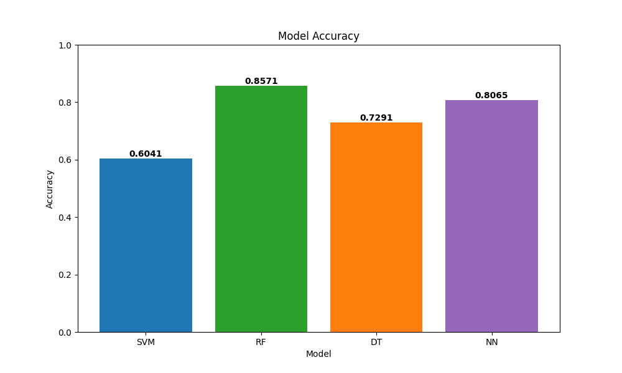
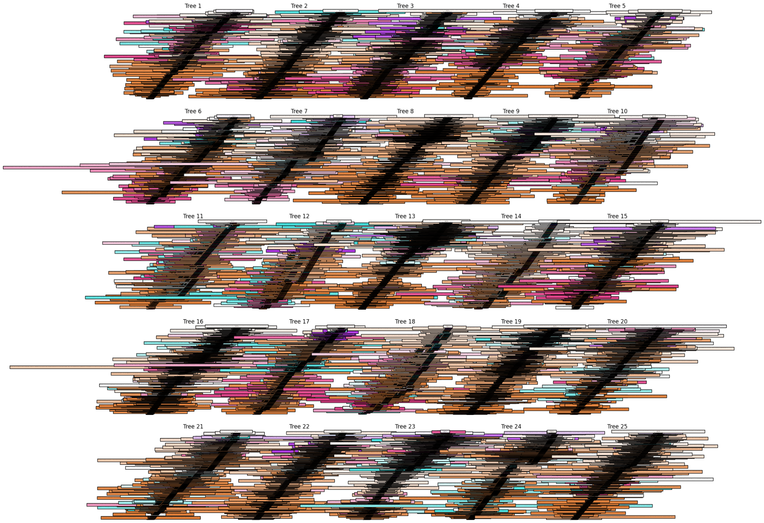
Random Forest Tree Snapshot

Slide 28
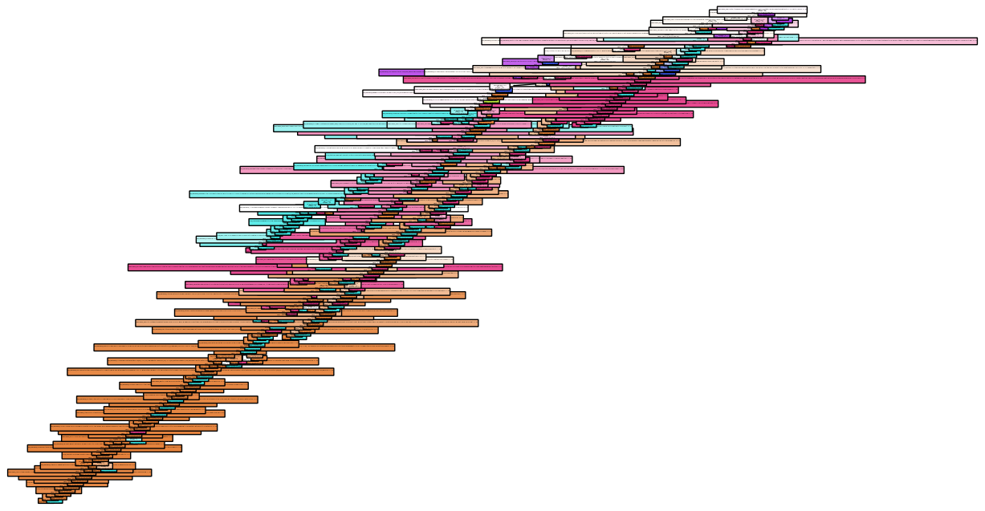
Visualize one decision tree from the forest

Slide 29
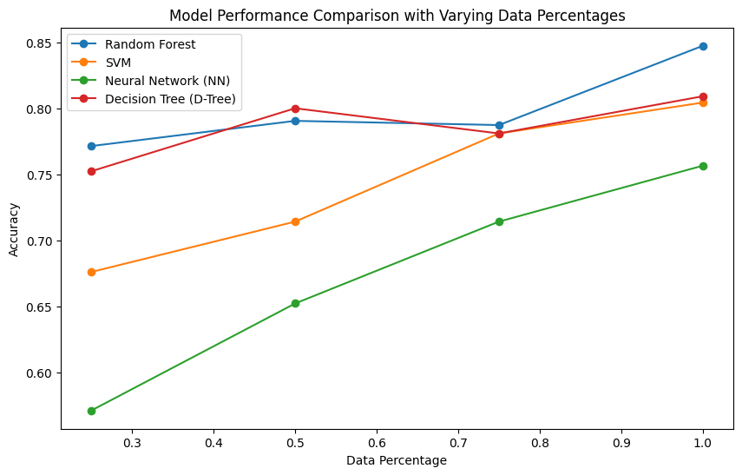

Slide 30
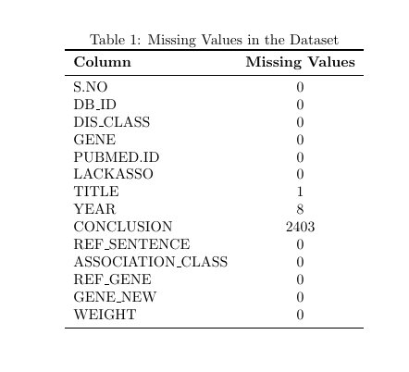
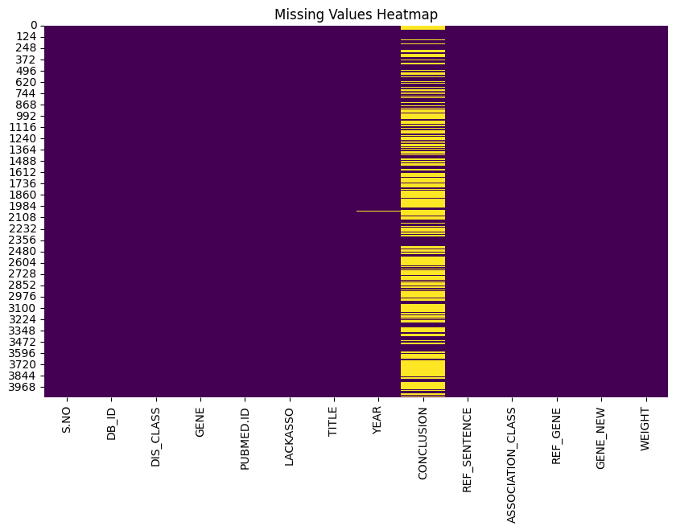

Slide 31
Conclusion & Future Work
Vast field of Research
Human Helpful Innovation
Medical Milestone
Need to Walk More
Hybrid Model
Feature Selection
Optimization
Interpretability
Applications

Slide 32
References
S. A. A. P. S. A. A. K. S. Raj and Alok, ““benchmark gene reference data for breast cancer”, mendeley data, v2, doi: 10.17632/xdkvk75ns7.2,”
S. P.-A. S. J. B. D. R. W. A. P.-L. A. G. B. H. Dessailly, “Benchmarking network propagation methods for disease gene identification,” 2019.
S. A. D. Majidian and C. C. et al., “Genomic variant benchmark: if you cannot measure it, you cannot improve it. genome biol 24, 221,” 2023.

Slide 33
Thank You!
Do you have any questions?

